Slide 1
End-to-End Object Detection for Transformers
“DETR”
Computer Vision for Autonomous Driving

Slide 2
Outline
Preceding methods
Proposed Method
Experimental Results
Discussion

Slide 3
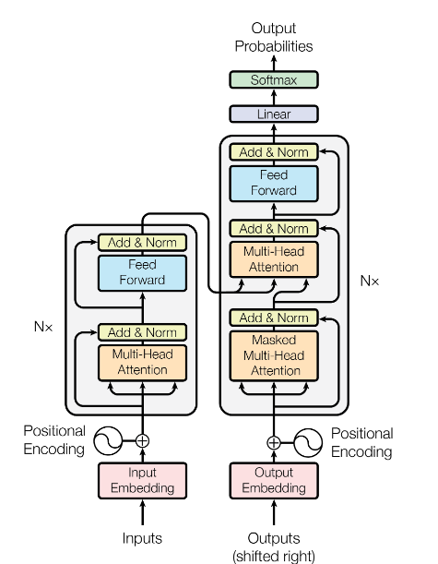
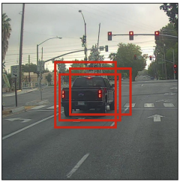
End-to-End / Object Detection / for Transformers
Non-max. suppression(NMS)
Transformer

Slide 4
The task of object detection;
Predict a set of bounding boxes with labels, given in an image
Classical approach to detection;
Popular approach: detection = classification of boxes
Requires selecting a subset of candidate boxes
Regression step to refine the predictions
Typically non-differentiable

Slide 5
DETR
Set prediction formulation (+)
No geometric priors (NMS, anchors…) (+)
Fully differentiable (+)
Competitive performance (+)
Extensible to other tasks (such as Panoptic Segmentation task) (+)
High computational cost in some models (-)
Less effective on small object (-)

Slide 6
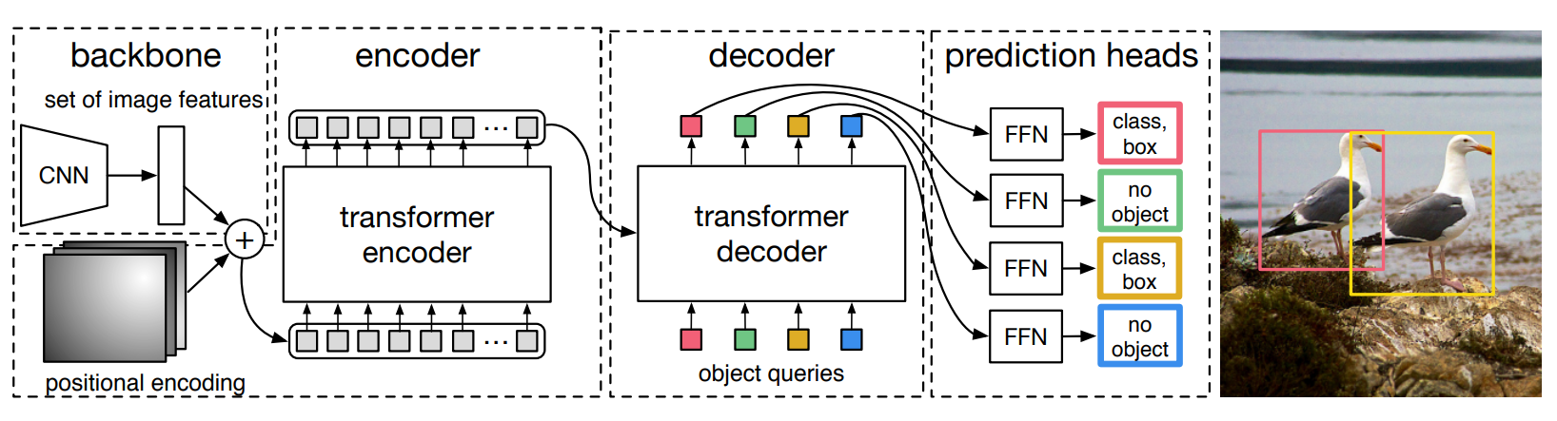
Architecture

Slide 7
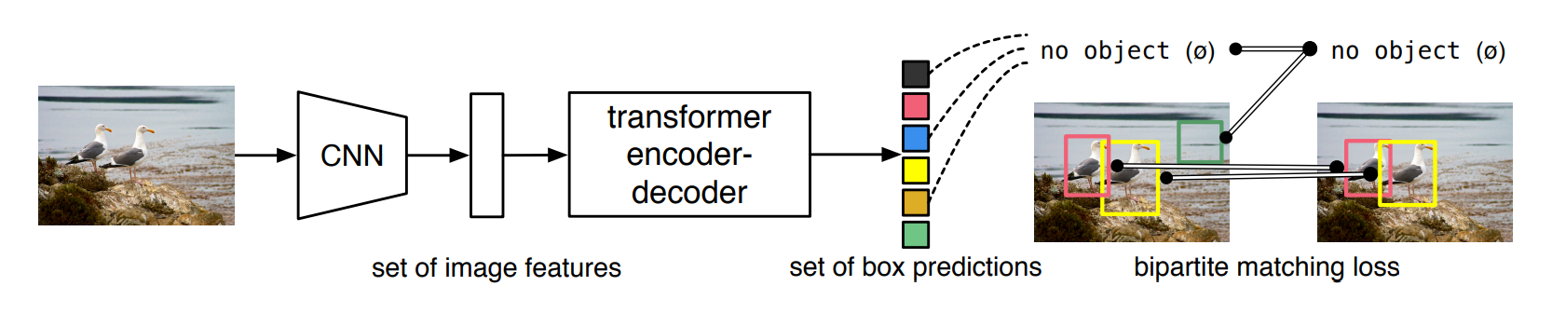
Bipartite Matching Loss

